Slide 1
Knowledge and reasoning – second part
Knowledge representation
Logic and representation
Propositional (Boolean) logic
Normal forms
Inference in propositional logic
Wumpus world example

Slide 2
Knowledge-Based Agent
Agent that uses prior or acquired knowledge to achieve its goals
Can make more efficient decisions
Can make informed decisions
Knowledge Base (KB): contains a set of representations of facts about the Agent’s environment
Each representation is called a sentence
Use some knowledge representation language, to TELL it what to know e.g., (temperature 72F)
ASK agent to query what to do
Agent can use inference to deduce new facts from TELLed facts
Domain independent algorithms
ASK
Inference engine
TELL
Knowledge Base
Domain specific content

Slide 3
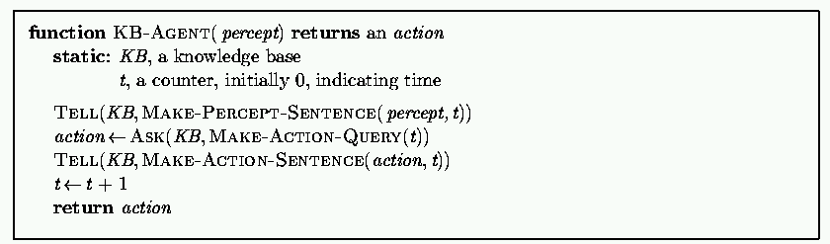
Generic knowledge-based agent
TELL KB what was perceived Uses a KRL to insert new sentences, representations of facts, into KB
ASK KB what to do. Uses logical reasoning to examine actions and select best.

Slide 4
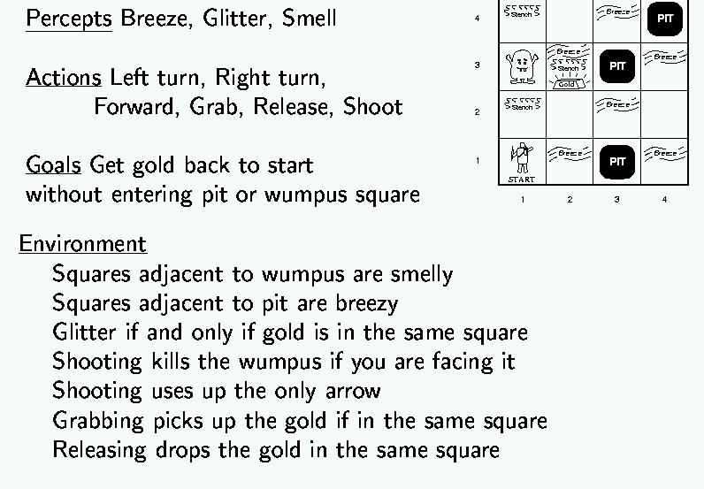

Wumpus world example

Slide 5
Wumpus world characterization
Deterministic?
Accessible?
Static?
Discrete?
Episodic?

Slide 6
Wumpus world characterization
Deterministic? Yes – outcome exactly specified.
Accessible? No – only local perception.
Static? Yes – Wumpus and pits do not move.
Discrete? Yes
Episodic? (Yes) – because static.

Slide 7
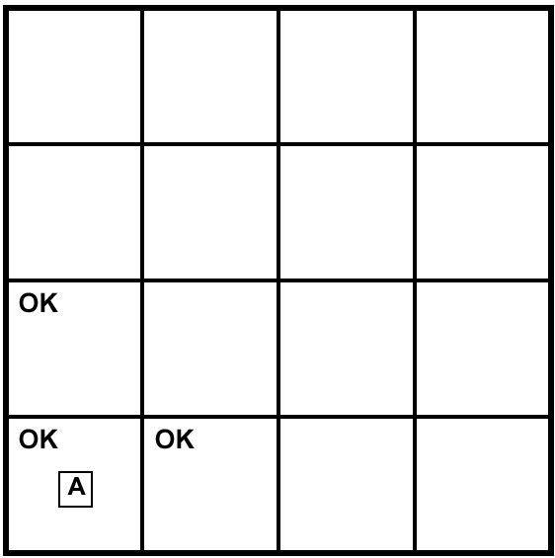
Exploring a Wumpus world
A= Agent
B= Breeze
S= Smell
P= Pit
W= Wumpus
OK = Safe
V = Visited
G = Glitter

Slide 8
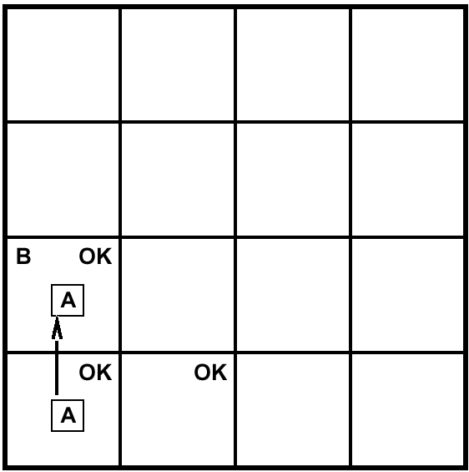
Exploring a Wumpus world
A= Agent
B= Breeze
S= Smell
P= Pit
W= Wumpus
OK = Safe
V = Visited
G = Glitter

Slide 9
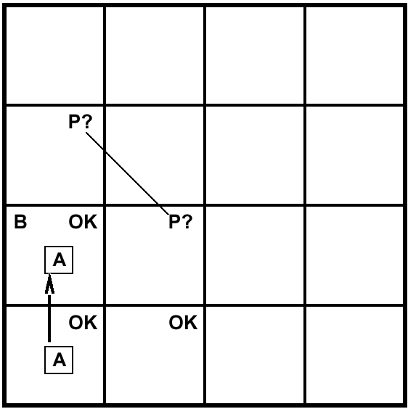
Exploring a Wumpus world
A= Agent
B= Breeze
S= Smell
P= Pit
W= Wumpus
OK = Safe
V = Visited
G = Glitter

Slide 10
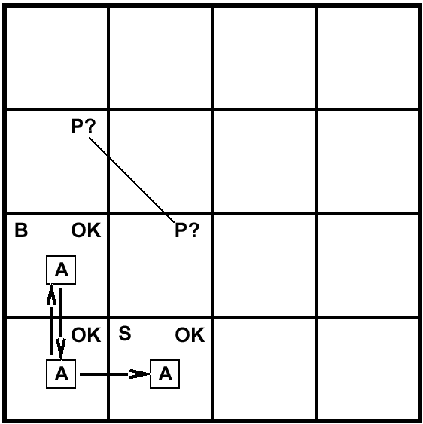
Exploring a Wumpus world
A= Agent
B= Breeze
S= Smell
P= Pit
W= Wumpus
OK = Safe
V = Visited
G = Glitter

Slide 11
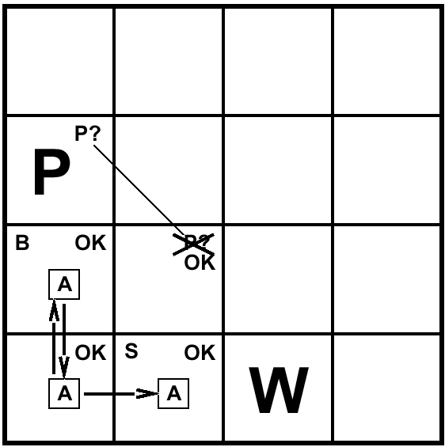
Exploring a Wumpus world
A= Agent
B= Breeze
S= Smell
P= Pit
W= Wumpus
OK = Safe
V = Visited
G = Glitter

Slide 12

Exploring a Wumpus world
A= Agent
B= Breeze
S= Smell
P= Pit
W= Wumpus
OK = Safe
V = Visited
G = Glitter

Slide 13
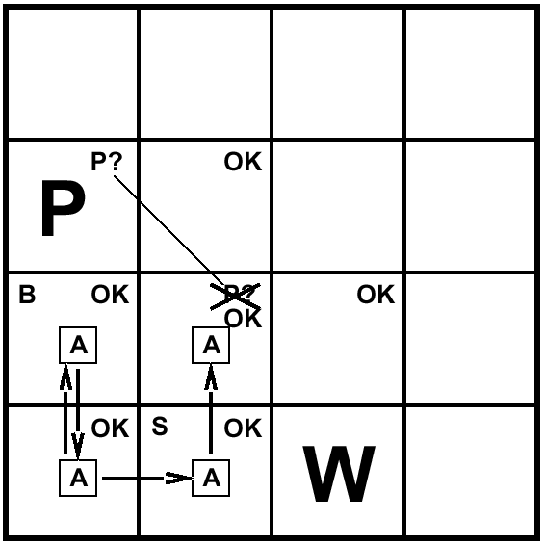
Exploring a Wumpus world
A= Agent
B= Breeze
S= Smell
P= Pit
W= Wumpus
OK = Safe
V = Visited
G = Glitter

Slide 14
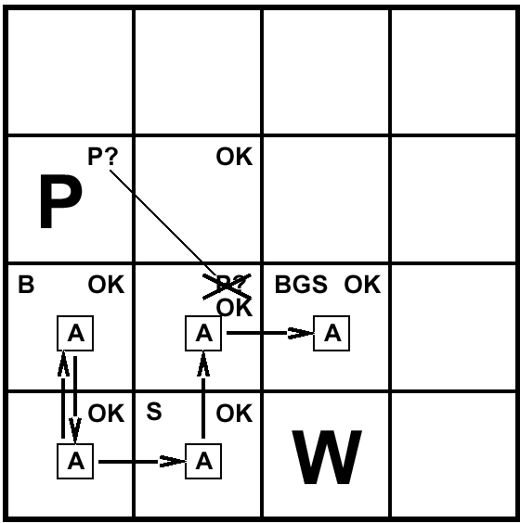
Exploring a Wumpus world
A= Agent
B= Breeze
S= Smell
P= Pit
W= Wumpus
OK = Safe
V = Visited
G = Glitter

Slide 15
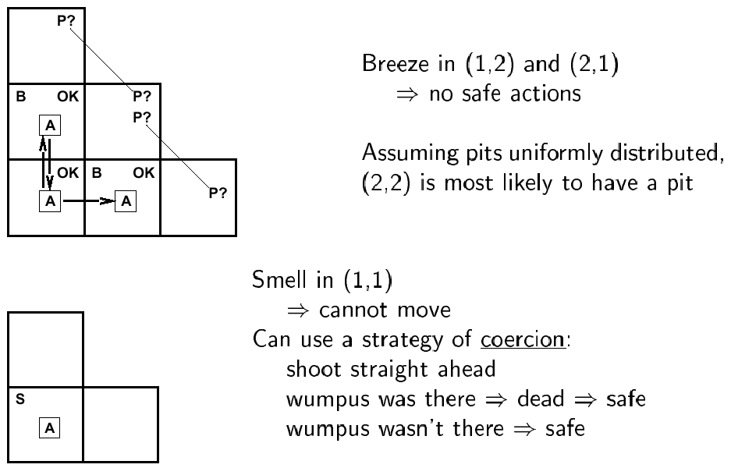
Other tight spots

Slide 16
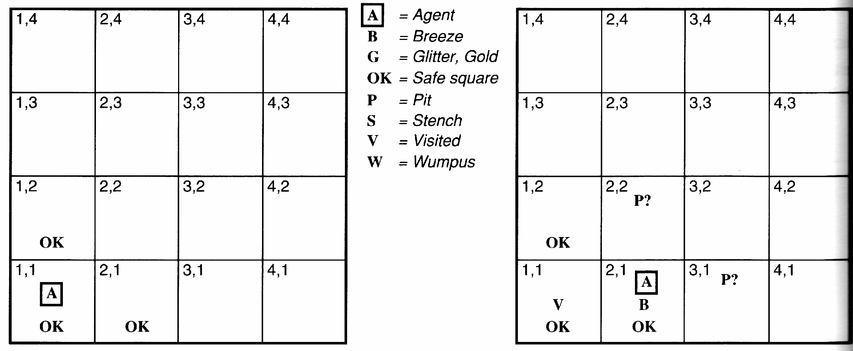
Another example solution
No perception → 1,2 and 2,1 OK
Move to 2,1
B in 2,1 → 2,2 or 3,1 P?
1,1 V → no P in 1,1
Move to 1,2 (only option)

Slide 17
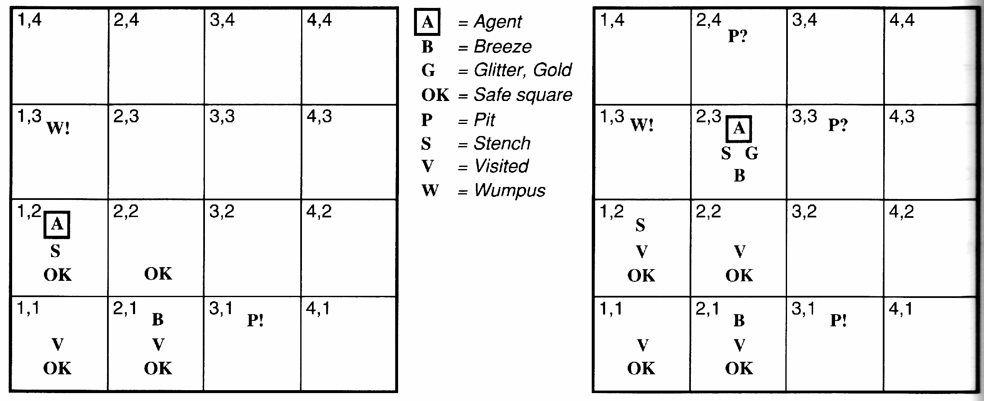
Example solution
S and No S when in 2,1 → 1,3 or 1,2 has W
1,2 OK → 1,3 W
No B in 1,2 → 2,2 OK & 3,1 P

Slide 18
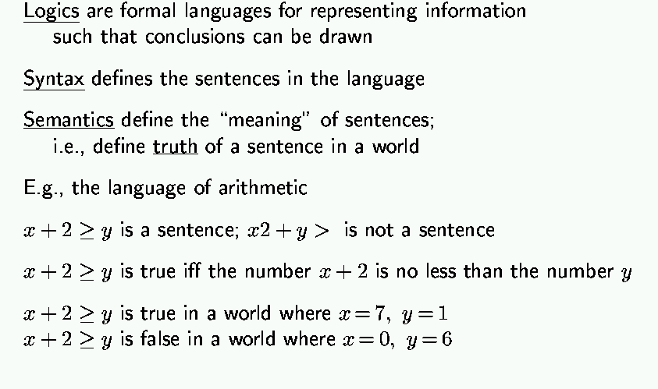
Logic in general

Slide 19
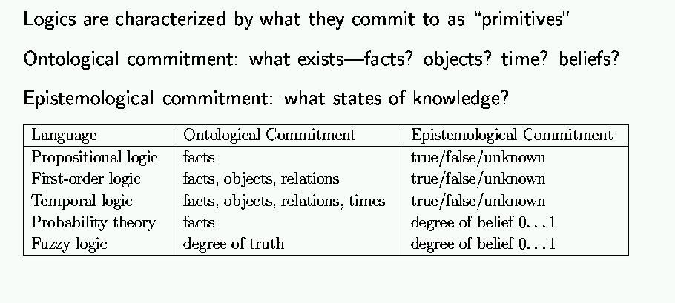
Types of logic

Slide 20
The Semantic Wall
Physical Symbol System World
+BLOCKA+
+BLOCKB+
+BLOCKC+
P₁:(IS_ON +BLOCKA+ +BLOCKB+)
P₂:((IS_RED +BLOCKA+)
Notes:
Syntax: says what is allowed on the LHS
Semantics: says how what is on the LHS relates to what is on the RHS
Inference: says how you can manipulate (formally, i.e., with no reference to the RHS) the symbols. [remember PSSH]
Want to be able to trust the results: want whatever the inference procedure does to “respect” what’s true or what follows in the world. So this is where we’re headed; good to keep in mind as we go through all the definitions now to follow. There is a method in this madness...
algebra example (put on board): but don’t use “entails” instead convey the idea
> n m: is this true or false? don’t know
if n=3, m=5, and > has its usual meaning, then (>n m) is false
(> n m) and (> m p) entail (n p)

Slide 21
Truth depends on Interpretation
Representation 1 World
A
B
ON(A,B) T
ON(B,A) F
ON(A,B) F A
ON(B,A) T B
Notes:
block pictures
(on A B) and on(B C) entails (on A C)
(again don’t say “entails)
for this as well as for number example jus t did, need transitivity relationships
spend time on why it matters: if build a KB want to be able to verify its answers
introduce notion of “refer” “mean” idea of mapping into world; for this slide handwave about meaning of “on(a,b)”

Slide 22
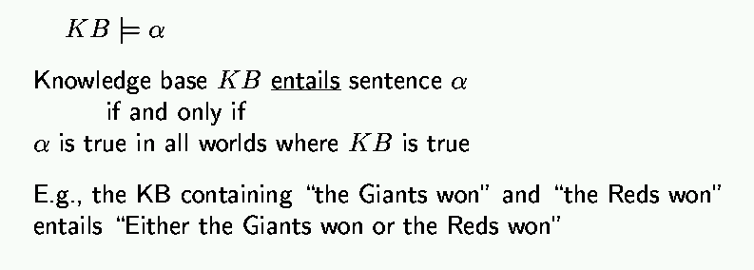
Entailment
Entailment is different than inference

Slide 23
Logic as a representation of the World
entails
Representation: Sentences
Sentence
Refers to
(Semantics)
follows
Fact
World
Facts

Slide 24
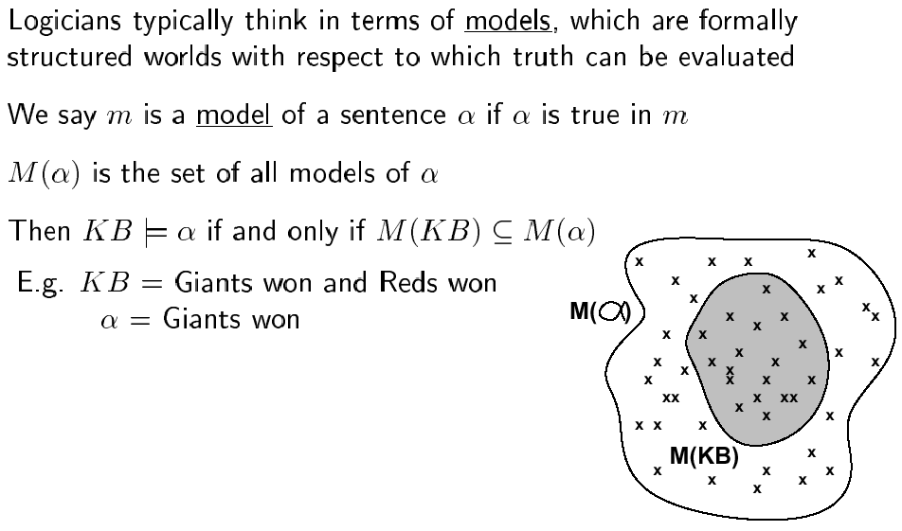
Models

Slide 25
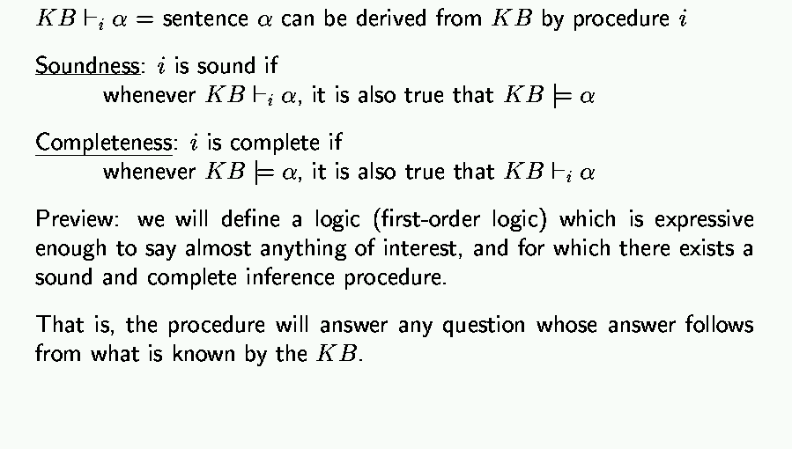
Inference

Slide 26
Basic symbols
Expressions only evaluate to either “true” or “false.”
P “P is true”
¬P “P is false” negation
P V Q “either P is true or Q is true or both” disjunction
P ^ Q “both P and Q are true” conjunction
P => Q “if P is true, then Q is true” implication
P ⬄ Q “P and Q are either both true or both false” equivalence

Slide 27
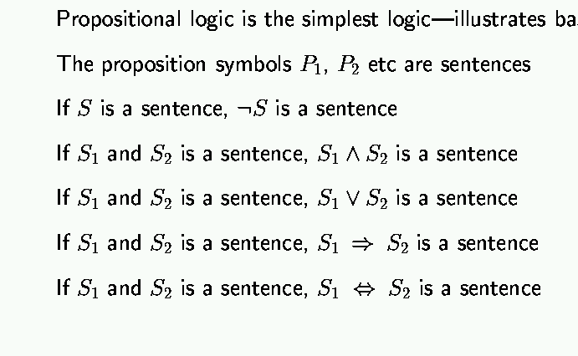
Propositional logic: syntax

Slide 28
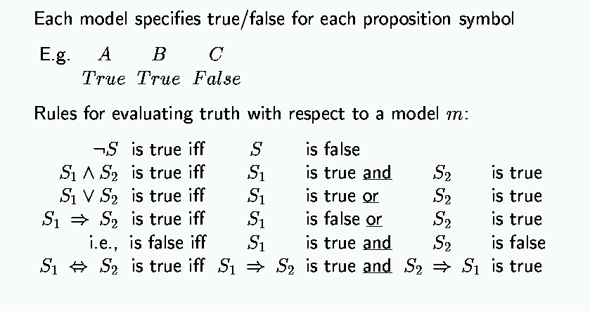
Propositional logic: semantics

Slide 29
Truth tables
Truth value: whether a statement is true or false.
Truth table: complete list of truth values for a statement given all possible values of the individual atomic expressions.
Example:
P Q P V Q
T T T
T F T
F T T
F F F

Slide 30
Truth tables for basic connectives
P Q ¬P ¬Q P V Q P ^ Q P=>Q P⬄Q
T T F F T T T T
T F F T T F F F
F T T F T F T F
F F T T F F T T

Slide 31
Propositional logic: basic manipulation rules
¬(¬A) = A Double negation
¬(A ^ B) = (¬A) V (¬B) Negated “and”
¬(A V B) = (¬A) ^ (¬B) Negated “or”
A ^ (B V C) = (A ^ B) V (A ^ C) Distributivity of ^ on V
A V (B ^ C) = (A V B) ^ (A V C) Distributivity of V on ^
A => B = (¬A) V B by definition
¬(A => B) = A ^ (¬B) using negated or
A ⬄ B = (A => B) ^ (B => A) by definition
¬(A ⬄ B) = (A ^ (¬B))V(B ^ (¬A)) using negated and & or
…

Slide 32
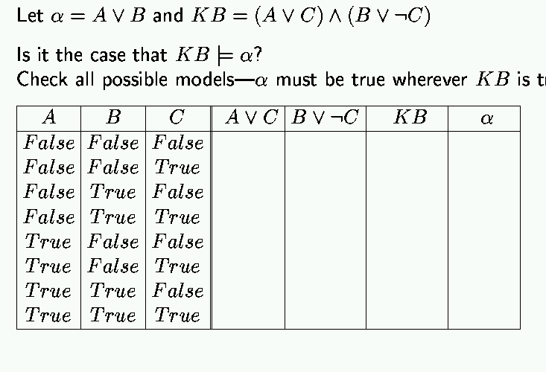
Propositional inference: enumeration method
true

Slide 33
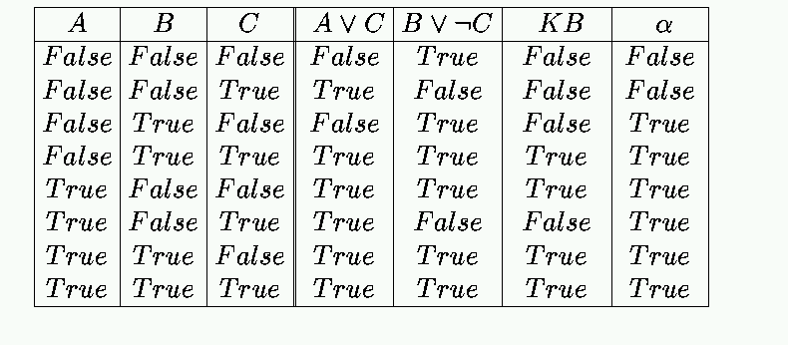
Enumeration: Solution

Slide 34
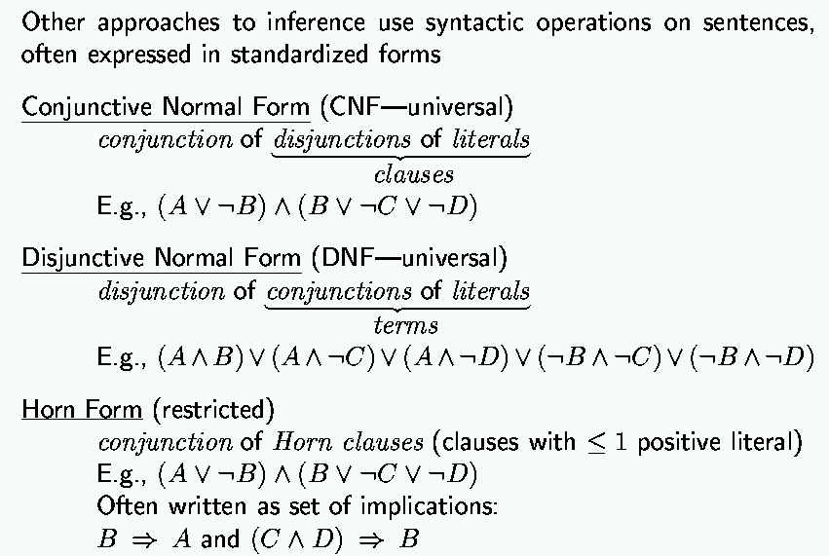
Propositional inference: normal forms
“product of sums of
simple variables or
negated simple variables”
“sum of products of
simple variables or
negated simple variables”

Slide 35
Deriving expressions from functions
Given a boolean function in truth table form, find a propositional logic expression for it that uses only V, ^ and ¬.
Idea: We can easily do it by disjoining the “T” rows of the truth table.
Example: XOR function
P Q RESULT
T T F
T F T P ^ (¬Q)
F T T (¬P) ^ Q
F F F
RESULT = (P ^ (¬Q)) V ((¬P) ^ Q)

Slide 36
Deriving expressions from functions
Given a boolean function in truth table form, find a propositional logic expression for it that uses only V, ^ and ¬.
Idea: We can easily do it by disjoining the “T” rows of the truth table.
Example: XOR function
P Q RESULT
T T F
T F T P ^ (¬Q)
F T T (¬P) ^ Q
F F F
RESULT = (P ^ (¬Q)) V ((¬P) ^ Q)

Slide 37
A more formal approach
To construct a logical expression in disjunctive normal form from a truth table:
Build a “minterm” for each row of the table, where:
- For each variable whose value is T in that row, include
the variable in the minterm
- For each variable whose value is F in that row, include
the negation of the variable in the minterm
- Link variables in minterm by conjunctions
The expression consists of the disjunction of all minterms.

Slide 38
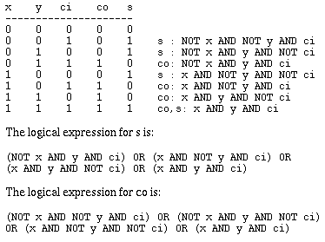
Example: adder with carry
Takes 3 variables in: x, y and ci (carry-in); yields 2 results: sum (s) and carry-out (co). To get you used to other notations, here we assume T = 1, F = 0, V = OR, ^ = AND, ¬ = NOT.
co is:
s is:

Slide 39
Tautologies
Logical expressions that are always true. Can be simplified out.
Examples:
T
T V A
A V (¬A)
¬(A ^ (¬A))
A ⬄ A
((P V Q) ⬄ P) V (¬P ^ Q)
(P ⬄ Q) => (P => Q)

Slide 40
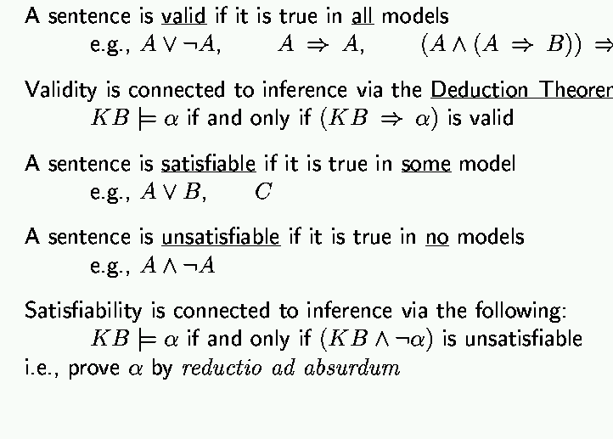
Validity and satisfiability
B
Theorem

Slide 41
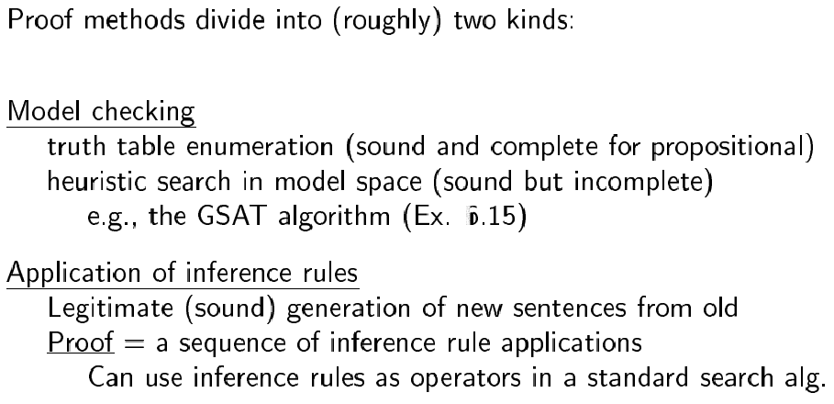
Proof methods

Slide 42
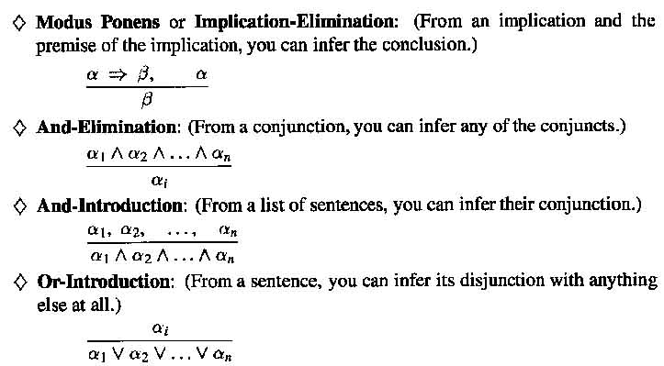
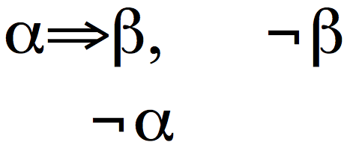
Inference Rules
Modus Tollens:

Slide 43
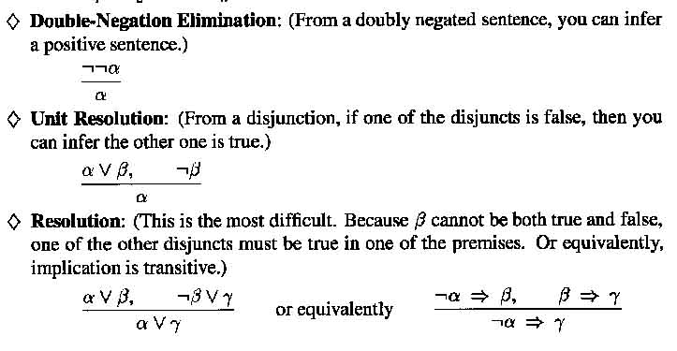
Inference Rules

Slide 44
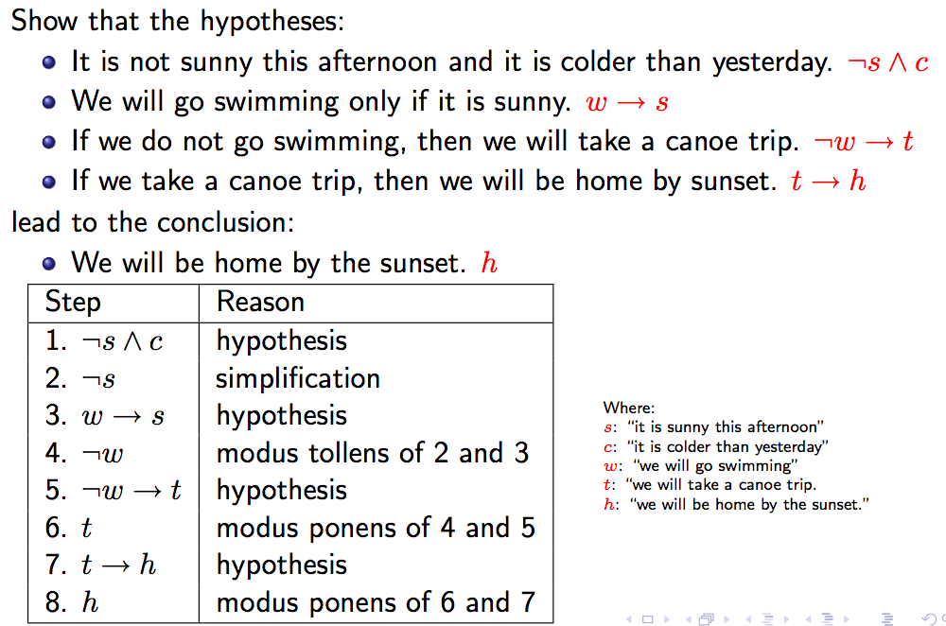
Inference example
http://www.site.uottawa.ca/~lucia/courses/2101-10/lecturenotes/04InferenceRulesProofMethods.pdf

Slide 45
Inference example
http://www.site.uottawa.ca/~lucia/courses/2101-10/lecturenotes/04InferenceRulesProofMethods.pdf

Slide 46
Inference example
http://www.site.uottawa.ca/~lucia/courses/2101-10/lecturenotes/04InferenceRulesProofMethods.pdf

Slide 47
Inference example
http://www.site.uottawa.ca/~lucia/courses/2101-10/lecturenotes/04InferenceRulesProofMethods.pdf

Slide 48
Inference example
http://www.site.uottawa.ca/~lucia/courses/2101-10/lecturenotes/04InferenceRulesProofMethods.pdf

Slide 49
Inference example
http://www.site.uottawa.ca/~lucia/courses/2101-10/lecturenotes/04InferenceRulesProofMethods.pdf

Slide 50
Inference example
http://www.site.uottawa.ca/~lucia/courses/2101-10/lecturenotes/04InferenceRulesProofMethods.pdf

Slide 51
Inference example
http://www.site.uottawa.ca/~lucia/courses/2101-10/lecturenotes/04InferenceRulesProofMethods.pdf

Slide 52
Inference example
http://www.site.uottawa.ca/~lucia/courses/2101-10/lecturenotes/04InferenceRulesProofMethods.pdf

Slide 53
Inference example
http://www.site.uottawa.ca/~lucia/courses/2101-10/lecturenotes/04InferenceRulesProofMethods.pdf

Slide 54
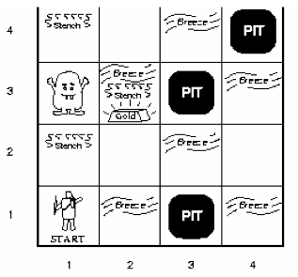
Wumpus world: example
Facts: Percepts inject (TELL) facts into the KB
[stench at 1,1 and 2,1] → S1,1 ; S2,1
Rules: if square has no stench then neither the square or adjacent squares contain the wumpus
R1: ¬S1,1 ⇒¬W1,1 ∧ ¬W1,2 ∧ ¬W2,1
R2: ¬S2,1 ⇒¬W1,1 ∧¬W2,1 ∧ ¬W2,2 ∧ ¬W3,1
…
Inference:
KB contains ¬S1,1 then using Modus Ponens we infer ¬W1,1 ∧ ¬W1,2 ∧ ¬W2,1
Using And-Elimination we get: ¬W1,1 ¬W1,2 ¬W2,1
…

Slide 55
Limitations of Propositional Logic
1. It is too weak, i.e., has very limited expressiveness:
Each rule has to be represented for each situation: e.g., “don’t go forward if the wumpus is in front of you” takes 64 rules
2. It cannot keep track of changes:
If one needs to track changes, e.g., where the agent has been before then we need a timed-version of each rule. To track 100 steps we’ll then need 6400 rules for the previous example.
Its hard to write and maintain such a huge rule-base
Inference becomes intractable

Slide 56
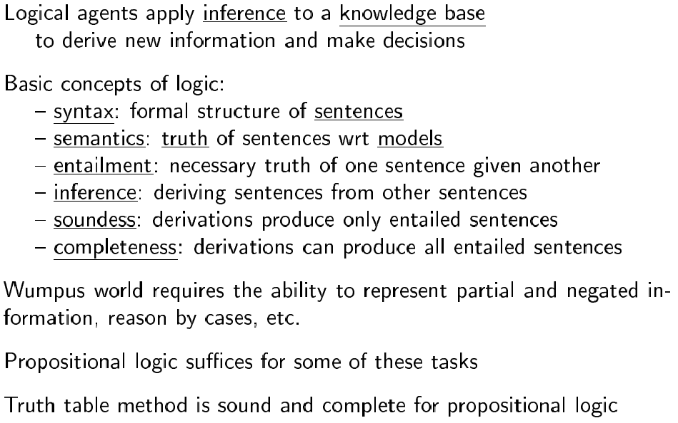
Summary

Slide 57
Next time
First-order logic: [AIMA] Chapter 7

